Slide 1
Leprosy Post-Exposure Prophylaxis with Single-Dose Rifampicin
Toolkit - Policy

Slide 2
How to use this slide deck
Before use, adapt the presentation to your country specific situation.
Review the colored text and edit it:
Selection: «i», «ii», «iii» etc: choose the appropriate answer (delete the others)
Addition: «__», insert the appropriate number/word
Suggestion/comment: can be deleted if not appropriate for a given setting
Pictures can be updated to reflect the country situation
Choose slide corporate identity, insert logos etc.

Slide 3
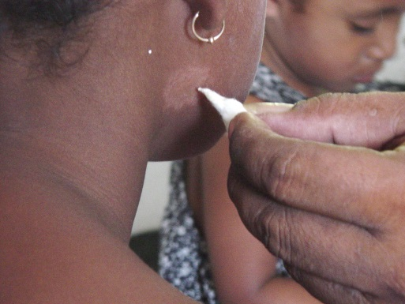
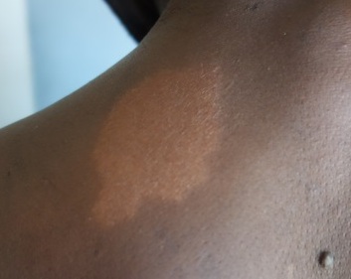
Mycobacterium leprae infection
Leprosy is a disease caused by Mycobacterium leprae.
The disease affects mainly peripheral nerves, the skin and the upper respiratory tract.
Infection after long-term (months) exposure or inoculation
Rapid diagnostic tests are not available.
Diagnosis 1) clinical examination: skin lesions consistent with leprosy and with deifinite sensory loss, with our without thickened nerves. or2) positive skin smears
Testing of sensation
Hypopigmented patch

Slide 4
Diagnosis and classification
WHO classification: clinical diagnosis
  Paucibacillary (PB): 1-5 lesions, only 1 nerve involved
  Multibacillary (MB): >5 lesions, 2 or more nerves involved
Laboratory confirmation by skin smears (often not feasible in practice as laboratory infrastructure is needed):
  Negative: PB
  Positive: MB
Skin biopsy for negative skin smear (PB) and/or to rule out other differential diagnosis

Slide 5
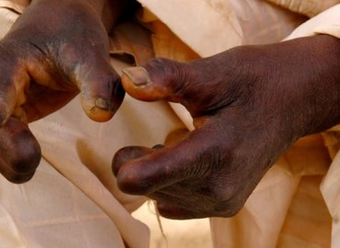
Transmission
Mode of transmission remains unclear
Prolonged (several months) contact to a patient with untreated leprosy increases the risk of developing the disease
But: Most contacts do not develop disease
Long incubation period : 2-5 years on average
Early case detection and treatment are key to reduce transmission and avoid development of disability
Disabled hands due to nerve damage and subsequent injuries

Slide 6
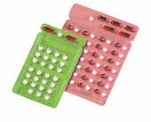
Treatment
Multidrug treatment (MDT)
  PB: rifampicin, dapsone (and optionally clofazimine) for 6 months
  MB: rifampicin, clofazimine and dapsone for 12 months
  Donated through WHO by Novartis
Prevention and management of disabilities
  Permanent nerve damage and loss of sensation develop due to late diagnosis, lack of follow-up and untimely treamtenent of reaction
  Avoid injuries, skin cracks and stiffness of affected limbs

Slide 7
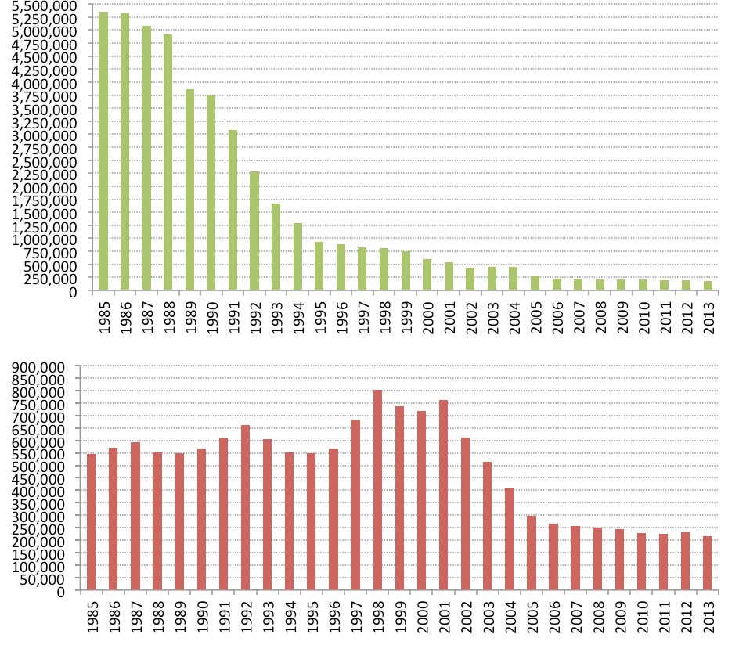
Global leprosy epidemiology I
1991: WHO passed resolution to eliminate leprosy as a public health problem (prevalence <1 case per 10’000 population) by 2000
1990-2000: Decrease in registered prevalence, due to progressive shortening of treatment duration (36 month vs 6-12 month)
Global leprosy registered prevalence and new case detection 1985-2013 (https://internationaltextbookofleprosy.org/chapter/epidemiology-leprosy)

Slide 8
Global leprosy epidemiology II
Goal to eliminate leprosy as a public health problem achieved globally in 2000, but pockets of high endemicity remain
Currently ̴200’000 new cases detected every year, including child cases, indicating transmission is ongoing in many endemic areas
  → Need for new interventions/tools to stop transmission!

Slide 9
Leprosy epidemiology in [country]
Eliminated leprosy as a public health problem in [year]
__ new cases in year ____
__ % MB in year ____
__ % female patients in year ____
__ % children in year____
__ % with Grade 2 disability in year ____
______ are the areas with the most cases
Data over the last 10 years would be interesting

Slide 10
Leprosy control in [country]
Leprosy control program organization and international partners: ____
Case detection approaches: ____
Treatment compliance, follow-up, release: ____
Prevention of Disabilties (PoD) programs: ____
Contact tracing: ____
Counselling
….

Slide 11
Approaches to case detection
Passive case detection: relies on patients presenting themselves to a health facility for diagnosis and treatment
Active case detection: relies on health workers tracing and screening at-risk population (contacts, villages, schools, factory workers etc.)
  → Passive case detection bears the risk of late diagnosis and therefore increased transmission and disability
  → Active case detection is resource-intensive

Slide 12
Risks for contacts of leprosy patients I
Contacts have increased risk of developing leprosy compared to the general population at three levels:
Physical distance
Genetic distance
Severity of leprosy in
index patient
(Moet et al. J Infect Dis 2006)

Slide 13
Risks for contacts of leprosy patients II
Contacts have increased risk of developing leprosy compared to the general population at three levels:
Physical distance
Genetic distance
Severity of leprosy
in index patient
(Moet et al. J Infect Dis 2006)

Slide 14
Risks for contacts of leprosy patients III
Contacts have increased risk of developing leprosy compared to the general population at three levels:
Physical distance
Genetic distance
Severity of leprosy
in index patient
(Moet et al. J Infect Dis 2006)

Slide 15
Post-exposure chemoprophylaxis
Post-exposure prophylaxis (PEP) reduces risk of progress to clinical disease but does not protect from future infection
In the 1970ies, PEP using dapsone or acedapsone showed promising results in preventing disease in contacts, but risk of drug resistance was there (daily and continuous prophylaxis) (Moet et al. BMJ 2008)

Slide 16
COLEP Study 2001-2009
Single-centre, cluster randomised, double blind, placebo-controlled trial in Bangladesh
1’000 leprosy index patients, 20’000 contacts
Single-dose rifampicin (SDR) or placebo to contacts of newly diagnosed leprosy patients, taking MDT for at least 6 weeks
Results:
    57% reduction of leprosy incidence among contacts treated with SDR after two years
    within first 2 years BCG has similar protective effect
    SDR and childhood BCG together have cumulative protective effects of 80%
    (Moet et al. Lepr Rev 2004 and Moet et al. BMJ 2008)

Slide 17

Rifampicin resistance
TB and leprosy experts concluded that giving SDR chemoprophylaysis to contacts of leprosy patients poses a negligible risk of inducing drug resistance in M. tuberculosis
"Regular sampling and molecular monitoring should be considered in areas with SDR chemoprophylxis."
(Mieras 2016 Infectious Diseases of Poverty)

Slide 18
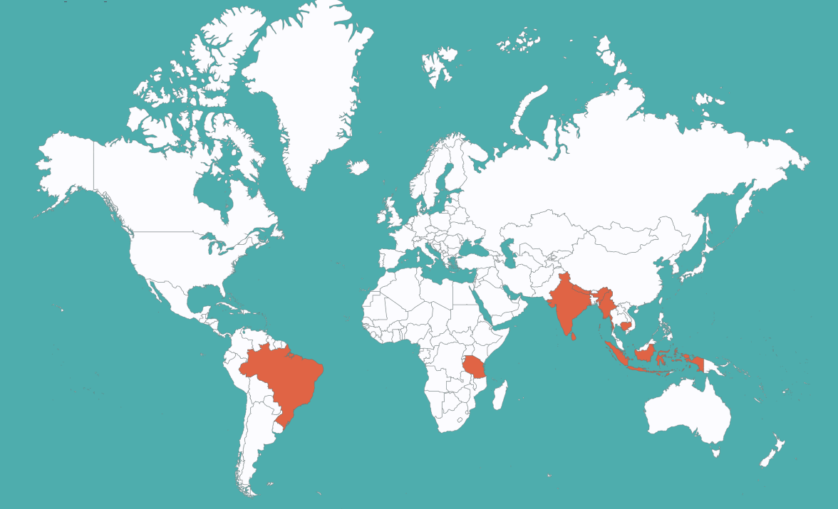

Leprosy Post-Exposure Prophylaxis (LPEP) program (2015-2018)
PEP with single dose rifampicin (SDR) for contacts of leprosy patients
3-year pilot in 8 countries in Asia, Africa and South America provides evidence on the feasibility and impact of PEP using SDR

Slide 19
LPEP settings
Mostly highly endemic areas
Various health systems
Different approaches are used for contact tracing:
  Regular approach leprosy health workers and community health volunteers identify and screen contacts according to specific definitions
  Blanket approach, treating the population of an entire village (Lingat) on a highly endemic island (Indonesia)
  Drives, a fix team of experts traces and screens all contacts of leprosy patients in a certain (Cambodia)

Slide 20
LPEP- activity flow
Index patient
Available contacts in catchment area
Contact tracing
Contact screening
Privacy, gender senitivity
Eligibility for SDR
None of the exclusion criteria is met
Recording & reporting
Paper based recording
SDR administration
Sufficient daylight/ portable LED daylight lamp
Screen entire body
Identify contacts and arrange meeting/ visit them
Possibly electronic reporting
Leprosy patient taking MDT since at least 1month
Refer suspected for confirmatory diagnosis
Dose according to age and weight
Use adequate formulation for children (sirup, tablets as available)
Willingness to participate

Slide 21
LPEP- contact definitions
In the various settings different contact definition are applied depending on resources and presumed acceptance of the intervention:
Household contacts (living under the same roof, using the same kitchen)
Neighbor contacts, all people living in a defined vicinity of the index patient (e.g. 5 surrounding houses)
Social contacts, people who spend a defined amount of time per week with the index patient (example: school mates, office colleagues, social gathering i.e. fellow worshippers)
Limited population survey

Slide 22
LPEP- interim results
High acceptance among index patients, contacts and health personnel
No adverse reactions to SDR among 109,727 contacts meeting inclusion criteria
Feasible in diverse settings with different health systems and leprosy epidemiology
406 new leprosy patients identified
Invigorated local leprosy control
Steinmann et al. Leprosy Review 2018

Slide 23
Ethical consideration
Every newly diagnosed leprosy patient is informed about leprosy PEP activities and is asked to consent the disclosure of his/her disease status to contacts. This process is of high importance and needs special attention in areas with high stigmatization of leprosy.
SDR-PEP administration is a tool that can successfully reduce the risk of developing disease and is advised by WHO

Slide 24
WHO global leprosy guidelines
WHO recommends post-exposure prophylaxis (PEP) using SDR, after having seen preliminary results of COLEP study and the LPEP program http://www.who.int/iris/handle/10665/274127

Slide 25
WHO global leprosy guidelines
“The guidelines recommend the use of single-dose rifampicin (SDR) as preventive treatment for adult and child (2 years of age and above) contacts of leprosy patients, after excluding leprosy and tuberculosis (TB) disease and in the absence of other contraindications…”

Slide 26
PEP - Minimal essential data
To ensure feasibility and keep the additional work load for the integration of PEP into the national program activities as low as possible, a minimal essential dataset has been proposed by the LPEP Study Group
(Richardus in Leprosy Review 2018).

Slide 27
PEP minimal essential data-
Index patient
The following indicators are suggested to be recorded, if not yet collected routinely (assuming that the WHO GLP reporting is already covering: age, sex, leprosy classification, and disability grade):
1. mode of detection (active, passive)
2. previous SDR (if known)
3. presence of contacts
4. index patient consent to disclosure (if needed)
5. list of i-household, ii-neighbor, iii-community/social, iv-other contacts and their details (address/phone number)

Slide 28
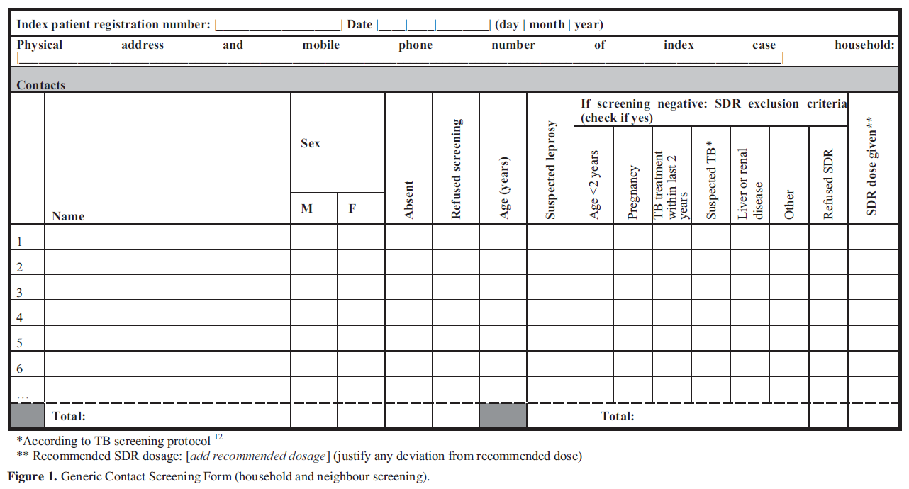
PEP minimal essential data-
Household and neighbor screening
Richardus et al. Lepr Rev (2018) 89, 2-12

Slide 29
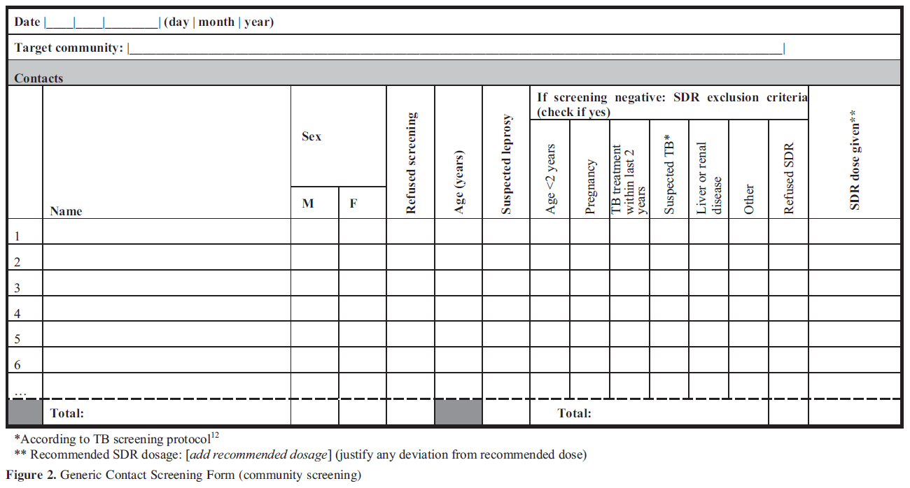
PEP minimal essential data- - Community screening
Richardus et al. Lepr Rev (2018) 89, 2-12

Slide 30
Single dose rifampicin supply
SDR in [country]:
  Rifampicin drug registration status
  Retail availability
  Authorization for SDR leprosy/ TB
  Availability of SDR syrup for children
Supply chain:
  Entity controling access to rifampicin

Slide 31
Costs
COLEP (Bangladesh): incremental cost-effectiveness ratio of <US$ 200 per case of leprosy averted. Costs may vary in other countries and indirect costs were not measured. (WHO 2018)
Experience from the 8 countries in LPEP show high costs and work load are associated with contact tracing but SDR administration causes little additional costs.

Slide 32
Ongoing chemoprophylaxis and immunoprophylaxis trials
PEOPLE (2018-2022) definition of optimal target popultion for leprosy PEP using single double dose rifampicin (SDDR) on Madagascar and the Comoroes
PEP4LEP (2018-2022) SDR PEP in a) community skin camps and b) health center-based household contacts to compare feasibility, cost-effectiveness and acceptabilityand using a SkinApp to facilitate diagnosis in Mozambique, Ethiopia and Tanzania
Maltalep (2013-2019) additive effect of SDR plus BCG
PEP++ (2017-2022) compares efficacy of PEP++ (multidose regimen moxifloxacin and rifampicin) with SDR PEP in close contacts who are sero-positive for leprosy antibodies
Brazil officially recomments (re)vaccination with BCG for contacts
LepVax: clinical trials with post-exposure prophylaxis vaccine

