Slide 1
Leprosy Post-Exposure Prophylaxis with Single-Dose Rifampicin Toolkit- Field Implemention

Slide 2
How to use this slide deck
Before use, adapt the presentation to your country specific situation. Look at the colored text and adapt it accordingly:
Selection: «i», «ii», «iii» etc, choose the appropriate (delete the others)
Addition: «__», insert the appropriate number/word
Suggestion/comment: can be deleted if not appropriate for a setting
Choose slide corporate identity, insert logos etc.

Slide 3
Introduction to Leprosy Post-exposure Prophylaxis (PEP)
Chemoprophylaxis using single dose rifampicin (SDR) reduces the risk of clinical leprosy in contacts by 57% (Moet et al. BMJ 2008)
A pilot in 8 countries in Asia, Africa and South America shows the feasibility and impact in diverese settings and health systems (Publications in progress)

Slide 4
SDR-PEP- activity flow
Index patient
Available contacts in catchment area
Contact tracing
Contact screening
Privacy, gender senitivity
Eligibility for SDR
None of the exclusion criteria is met
Recording & reporting
Paper based recording
SDR administration
Identify contacts and arrange meeting/ visit them
Possibly electronic reporting
Leprosy patient taking MDT since at least 1month
Dose according to age and weight
Use adequate formulation for children (sirup, tablets as available)
Willingness to participate
Sufficient daylight/ portable LED daylight lamp
Screen entire body
Refer suspected patients for confirmatory diagnosis

Slide 5
Site selection for SDR-PEP application
Criteria for selecting application areas:
  Prevalence above elimination as a public health problem (prevalence >1/10,000)
  Historic reason (eg. previous LPEP area)
  Etablished or to be established contact tracing system
  others

Slide 6
Index patient enrolment
i-physician, ii-MDT nurse, iii-health worker/PHC staff, iv-other identify eligible index patients according to the inclusion criteria for PEP:
Identified newly diagnosed leprosy patient
Taking MDT since at least 1-6 months
Willing to disclose his/her status to contacts if needed
Indentified contacts in the catchment area of the leprosy program

Slide 7
Index patient data
i-physician, ii-MDT nurse, iii- health worker/PHC staff, iv-other document the following indicators, if not collected routinely (WHO GLP reporting: age, sex, leprosy classification, and disability grade):
1. mode of detection (active, passive)
2. previous SDR (if known)
3. presence of contacts
4. index patient consent to disclosure (if needed)
5. list of i-household, ii-neighbor, iii-community/social, iv-other contacts and their details (address/phone number)
To facilitate data collection, 1-3/4/5 should be integrated into the basic leprosy cards/forms if possible.

Slide 8
Contact tracing
Contact definition: appropriate for local conditions and as broad as possible: i-household, ii-neighbor, iii-community/social, iv-contact time dependent definition (eg >20h/w), v-other
i-clinician, ii-nurse, iii-health worker, iv- PoD volunteers, v-para medical worker, vi-midwife, vii-leprosy inspector, ix-junior leprosy worker, x-other in charge of contact tracing, uses the contact list and arranges a meeting/visit at i-health center, ii- home, iii- hospital, iv- another place
If contact cannot be reached, follow up __ times
Allocate a unique contact ID incorporating the index case ID of the national leprosy register

Slide 9
Contact screening
i-nurse, ii-leprosy expert, iii- health worker/PHC worker, iv-contact tracer, v- para medical worker, vi-midwife, vii-junior leprosy worker, ix-leprosy inspector, x-MOH, xi-other screens entire body in a bright place (assure privacy, same gender as contact), test feeling of skin patches
Suspected new leprosy and TB cases are referred to i-clinic, ii-hospital, iii-health center, iv-leprosy expert, v-dermatologist, vi-clinician, vii-other for final diagnosis, fill referral form/register (if confirmation not done on site)
i-contact tracer, ii- contact screener, iii-other follows-up final diagnosis of referred contacts. If negative, continue to follow PEP activity flow for contacts; if positive, include as index case 1-6 months after MDT start (only if contact definition is wider than household); if confirmation not possible i-contact tracer, ii- contact screener, iii-other follows-up suspected leprosy patient after __ weeks
Additionally, pregnant women and children under the age cutoff could be followed up after giving birth and growing older.

Slide 10
Contact SDR eligibility
i-health worker, ii-midwife, iii-junior leprosy worker, iv-leprosy inspector, v-MOH, vi-para medical worker conducts SDR eligibility and administration
Exclusion criteria
Signs of leprosy
Signs of tuberculosis (cough, night sweats, unexplained fever, weight loss)
Pregnancy
Rifampicin in the last 2 years
History of liver or renal disease
Known allergy to rifampicin
Age below __ years
refusing SDR administration

Slide 11
Contact SDR administration
For all eligible contacts:
Use SDR i-tablets/capsules (150 mg units needed), ii-sirup, iii-a mix of tablets/capsules and syrup
SDR dose:
  Adult >35 kg receive 600 mg
  Adult <35 kg receive 450 mg
  Child 10-14 years receive 450 mg
  Child 5-9 years receive 300 mg
  Child 2-5 years receive 10-15 mg/kg bodyweight
  Child <20 kg receive 10-15 mg/kg bodyweight

Slide 12
Contact SDR administration
Inform contacts on possible side effects (especially red colorization of urine)
Provide contact person for adverse events reporting according to the national guidelines
Provide SDR with water (if tablet) under direct supervision
Provide a contact tracing card if used
According to local guidelines: check BCG vaccination status and refer for vaccination as applicable

Slide 13
Contact data collection
A referral register for suspected leprosy patients among contacts facilitates communication between screeners and diagnosing physician (if this is not the same person)
The following indicators (see next slides) need to be recorded at field level and reported to i-district, ii-province, iii-regional, iv-national level. Ideally these indicators are included into routine activities of the national leprosy program, if not yet there

Slide 14
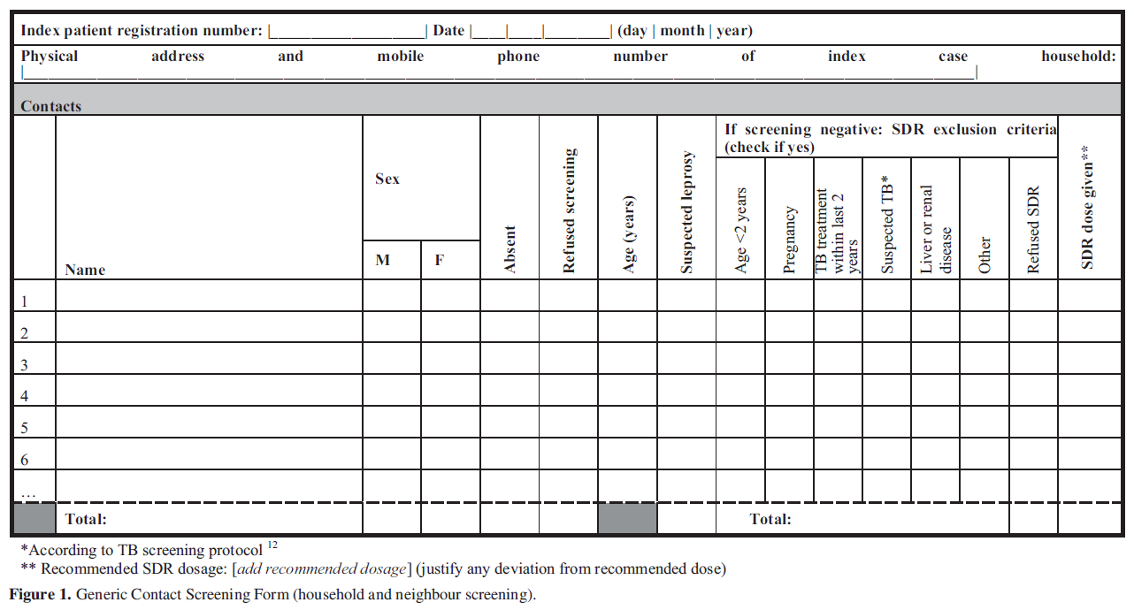
Household and neighbor screening minimal essential data
Richardus et al. Lepr Rev (2018) 89, 2-12

Slide 15
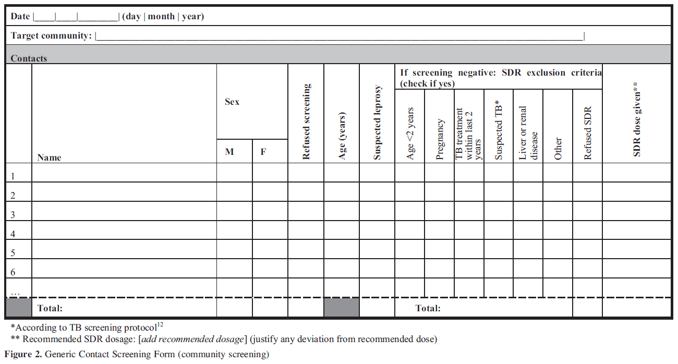
Community screening minimal essential data
Richardus et al. Lepr Rev (2018) 89, 2-12

Slide 16
Contact reporting
Field data need to be collected and forwarded/reported centrally on a i-weekly, ii-monthly, iii-other basis (at i-district level, ii-national level, iii-province level, iv-regional level, v-other) by i-DTLC, ii-other
A possible second reporting step, if applicable from eg. district to national level
Possible entry into an electronic database (ideally the national program database) by i-data clerk, ii-other
Reporting of i-individual, ii-summarized data according to the national program

Slide 17
SDR logistics and storage
Stock: __ doses = minimal amount that triggers resupply, __(name) manages stock, distribution (i) push, (ii)pull, (iii) other
Field: (i) contact tracer has own stock, (ii) contact tracer collects small amount before field work
Rifampicin should be protected from air, light and excessive heat (above 40°C) and moisture
Stock log files: __(name) is responsible for log file and reports to __(name)

Slide 18
Key tasks and persons
Task | Person responsible
Index case enrolment | _____(name/position)
Listing of contacts | _____(name/position)
Transfer of contact list to contact tracer | _____(name/position)
Contact tracing | _____(name/position)
Referral of suspected leprosy patients among contacts | _____(name/position)
Final diganosis of suspected contacts | _____(name/position)
Follow-up of contacts with negative outcome at referral | _____(name/position)
SDR administration to eligible contacts | _____(name/position)
SDR stock management | _____(name/position)
Data entry | _____(name/position)
Document printing and distribution | _____(name/position)

